Slide 1

Magist Data Analysis
Data Range: 09/2016 – 10/2018
Data Analysts:
Adrian Mihail
Helene Rebelo
Petri Tiirikainen
Tilman Vogel
Germany
23.11.23

Slide 2
Is Magist a good partner for Eniac?
Are deliveries fast enough?

Slide 3

Product Portfolio: Magist vs. Eniac
Magist
74 categories
9 Tech categories
=
ENIAC
Computer Accessories
Watches and Gifts
Cool Stuff
Electronics
Console Games
Computers
Tablets, printing, imaging
PC Gamer
Insurance and Services

Slide 4
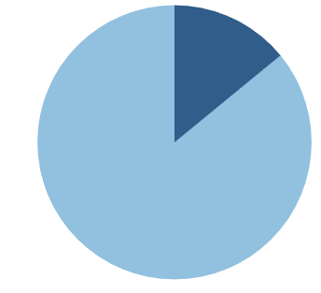
Amount of products sold by Magist
Tech Products
14 %
Total of 33K Products
15 % of total sales
Other Products
86 %
Source: Developed by the authors

Slide 5
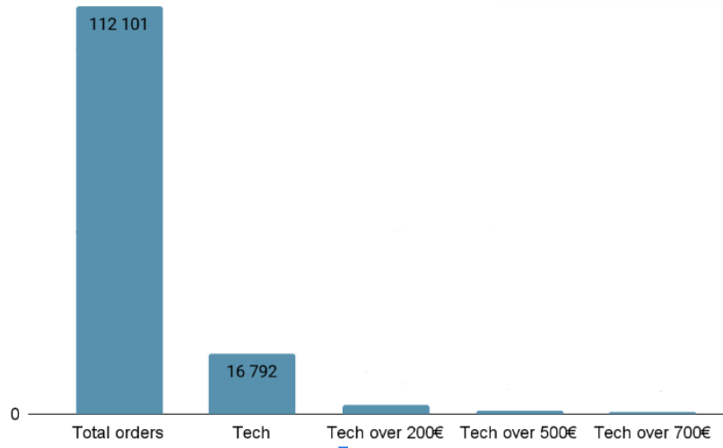
Tech categories sell less on Magist
ENIAC
average order price
710 €
15 % of total sales
Percentage from Tech sales
15%
6%
3%
Source: Developed by the authors

Slide 6
Magist Sellers
Only 11% sellers out of 3095 sellers have more than 50% sales from Tech
Notes:
(Thanks, ‘elene!)
Looked at sellers comparable to Eniac
Only 11% selling more than half in Tech

Slide 7
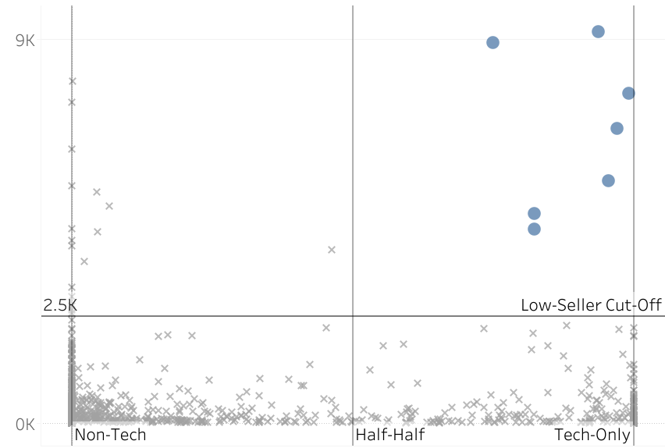
Magist Sellers: No precedent for Eniac
Maximum monthly sales:
9.2 K€
Eniac:
1.17 M€
Source: Developed by the authors
Notes:
And even only 7 of those sell more than 2,5K per month
Biggest seller sells 9,2K per month
Vast difference to 1,17 million that we sell

Slide 8
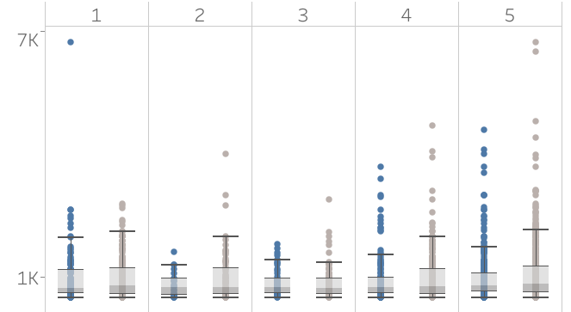
Customer Reviews: Expensive Tech handling acceptable
Customer Review Score
Review scores are similar:
Tech vs. Other
Across price range above 500€
Avg. review score:
Tech: 4.0
Other: 4.0
Source: Developed by the authors
Notes:
Analyzed whether tech products or more expensive products are more often involved in low customer review scores
We cannot identify convincing differences between tech and other product sales
Distribution of product prices for each score is roughly equal
Average review score for Tech and Others is 4.0 which seems OK
On to you, Petri

Slide 9
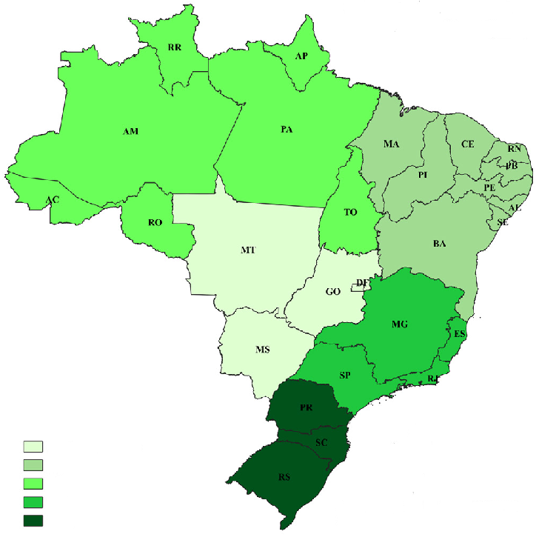
Map of Brazil with average delivery times
Average delivery
North
Brazilian Post = 13 days
22 days
Magist = 12 days
Northeast
20 days
Orders delivered late = 6.9%
Central-West
Total cancelled orders: = 0.5%
15 days
Southeast
10 days
Cancelled Tech products = 0.09%
Central-West
North East
North
Southeast
South
South
14 days
Source: Developed by the authors with data from correios.com.br, uol.com and Magist

Slide 10
Is Magist a good partner for Eniac? Are deliveries fast enough?
PRO
CON
Few Tech-Focused Sellers on Magist have the Highest Revenues
No issues in customer satisfaction with regards to expensive tech products
Delivery faster than Brazilian Post’s average - dependent on the region
Magist’s average product price is distinctively lower than Eniac’s
No match in Magist’s existing sellers for Eniac in Tech and revenues
Notes:
Coming back to the questions:
Is Magist a good partner for Eniac? Are deliveries fast enough?
We found out that few tech-focused sellers that partner Magist generate the highest revenues, way under our monthly revenues. This confirms our opportunity to step into a lucrative market segment.
We also don't see notable issues with customer satisfaction regarding expensive tech products. Considering our customer orientation, positive customer feedback and satisfactory experience is to be expected.
We concluded that deliveries are faster than the Brazilian Post's average, which leads to expectations of positive customer experience, dependent on the specific region.
Identifying the Magist's average product price is significantly lower than ours, this could pose challenges in maintaining profit margins.
Also finding that no sellers are performing already at our level in terms of revenue means consideration needed in the onboarding phase.
As a conclusion, we see
- Magist offers a cost advantage and high revenue potential in the tech market.
- Strategic onboarding efforts will be needed due to the absence of comparable sellers.
We remain available for questions and would like to hand-over the decision to the higher executive levels.
Thank you!

Slide 11

Notes:
shipping costs statista.com/statistics/769924/e-commerce-brazil-shipping-cost-checkout/

